Slide 1


FORECASTING SALES OF STORE USING IBM WATSON STUDIO
Team – AI Project 5
Members ->
1. Riddhirup Bera - 19BCE1169
2. Peddinti Vishnu Chakradhar Reddy - 18BCE7154
3. Subhro Mukherjee - 19BBS0142
4. Bharat Agarwal - 18bce7052
5. Siddhant Jain - 19bbs0134

Slide 2

INTRODUCTION
Forecasting of sales is an essential task for the management of a store. It is very important to be able to predict the sales of the store so as to be prepared with the inventory that they will need. So we are building a system that analyses the previous trends of sales which includes sales on various days and predicts future sales. This will be beneficial for both the store owners and customers as their will be sufficient supplies at all times.

Slide 3
PROBLEM STATEMENT
Build a project to forecast the sales of stores by using time series analysis using time series analysis algorithms such as RNN (Recurrent Neural Network) & LSTM (Long Term Short Memory) to analyze the past trends of sales of stores. Deploy flask-based web Application and integrate AI model to it.
The user should give the last ten days' sales values and get the prediction for the 11 th day which is showcased on the user interface.

Slide 4
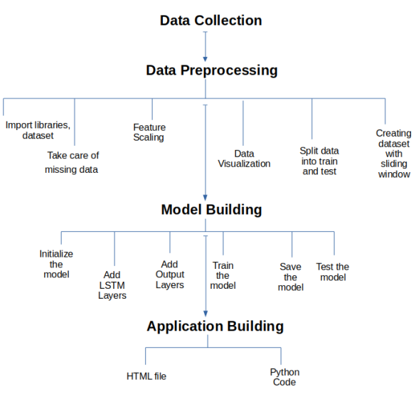
FLOW CHART OF SOLUTION

Slide 5
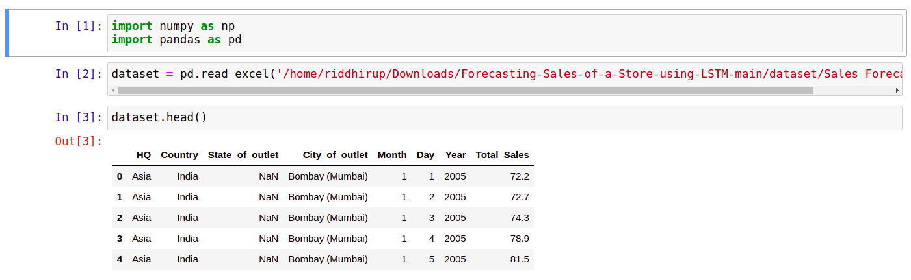
DATA COLLECTION

Slide 6
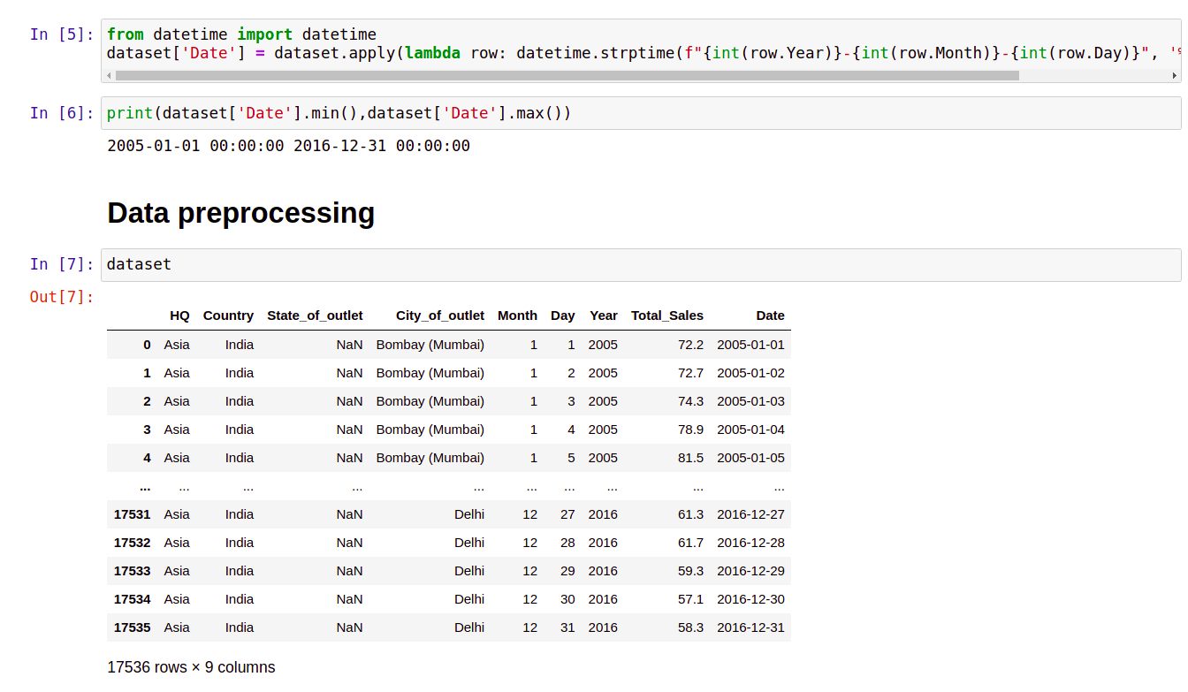
DATA PREPROCESSING

Slide 7
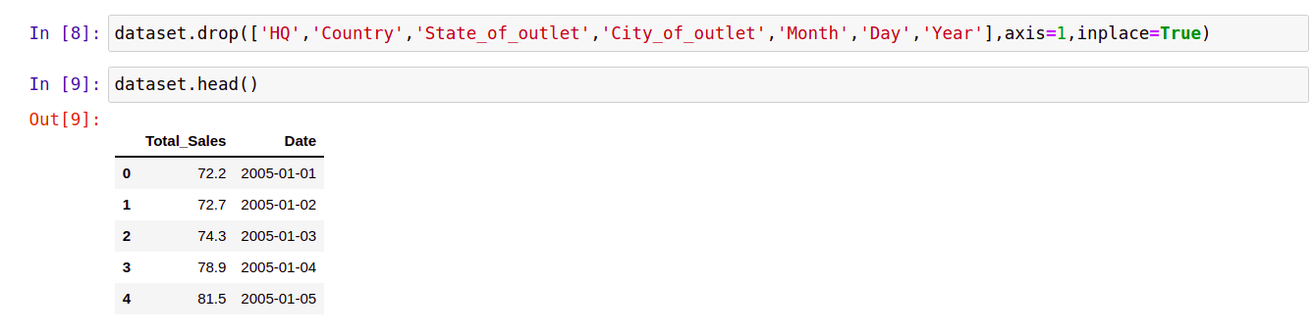
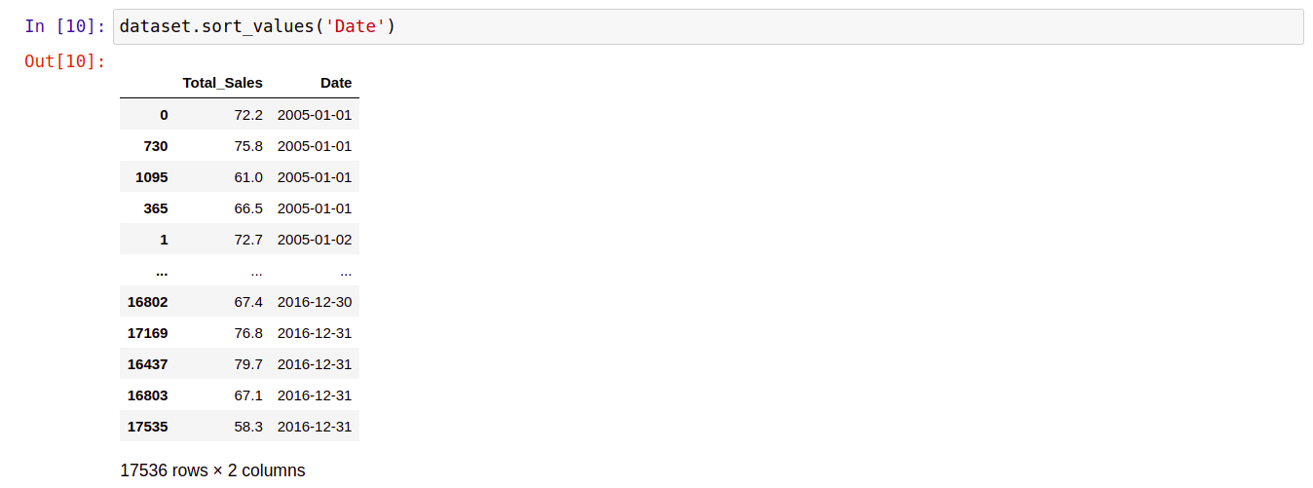
DATA PREPROCESSING

Slide 8
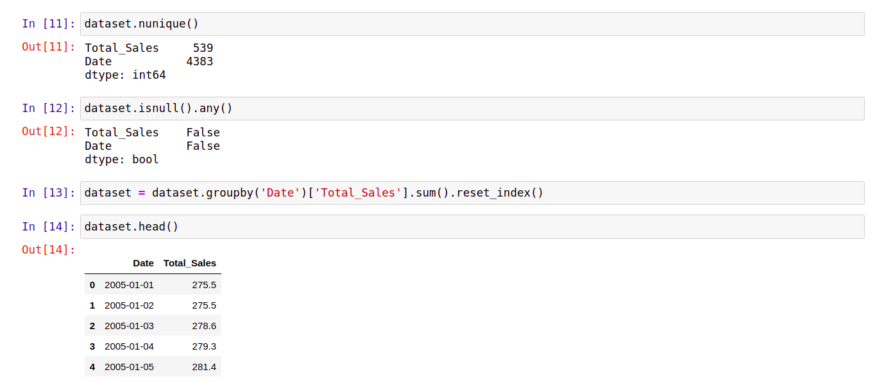
TAKING CARE OF MISSING DATA AND FURTHER PREPROCESSING

Slide 9
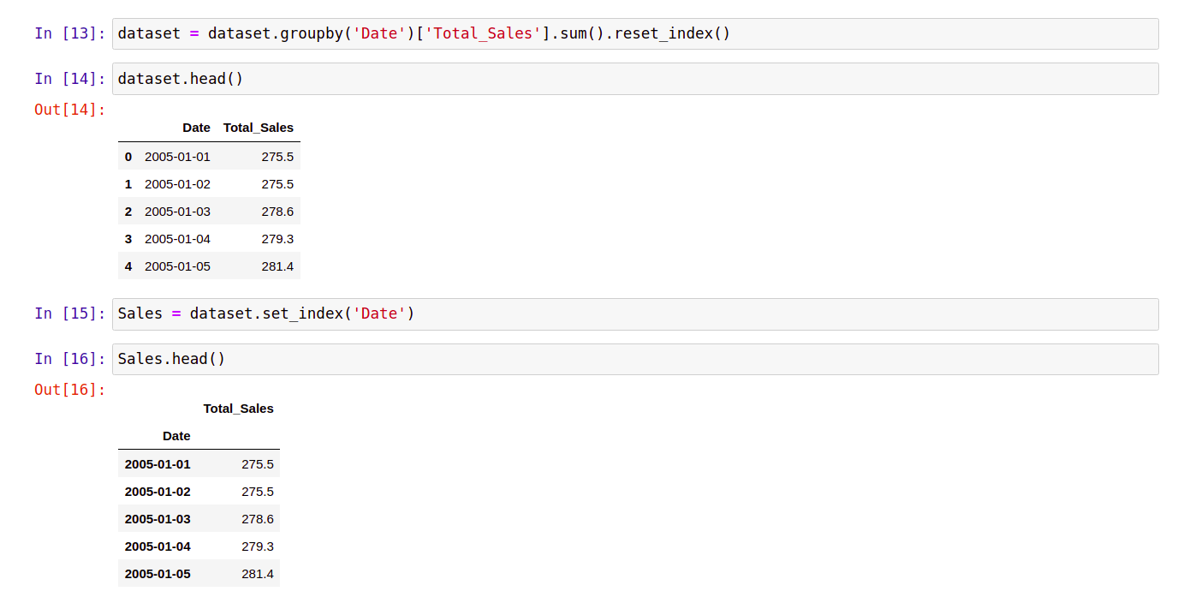
FURTHER PREPROCESSING

Slide 10
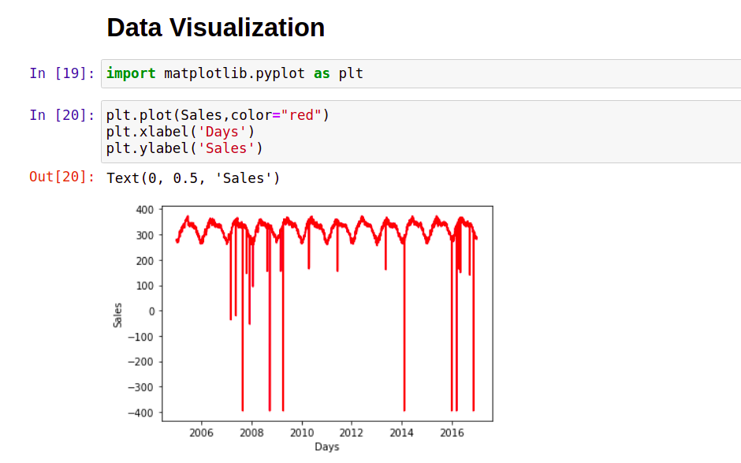
DATA VISUALIZATION

Slide 11
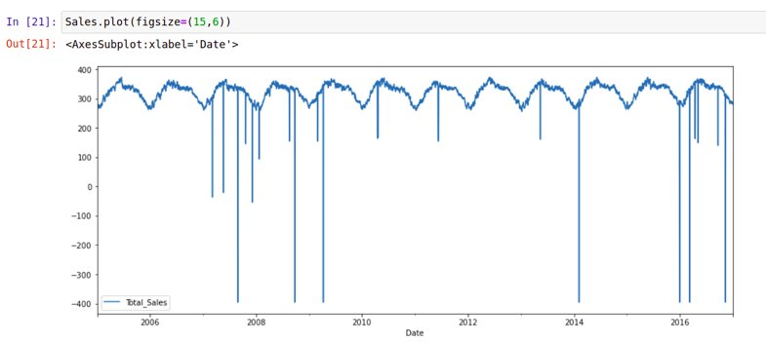
DATA VISUALIZATION

Slide 12
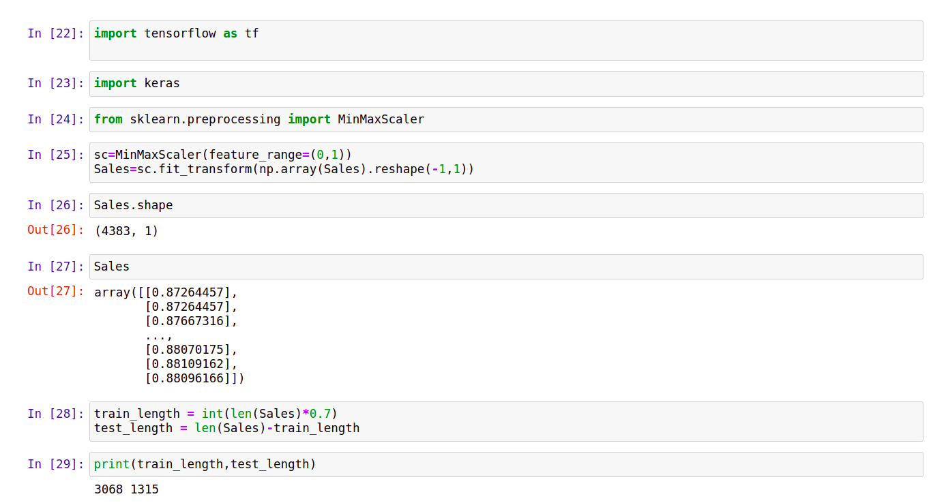
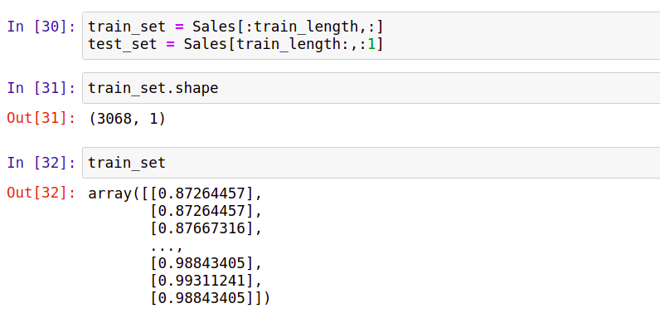
FEATURE SCALING

Slide 13
SPLITTING DATA INTO TRAIN AND TEST SET

Slide 14
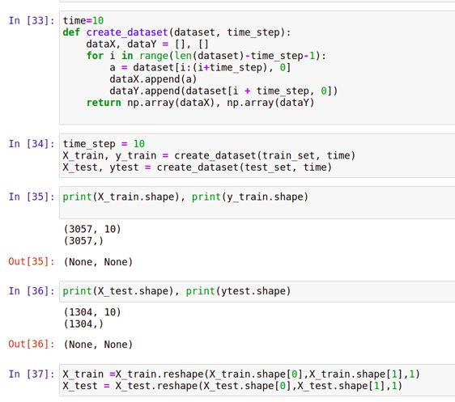
CREATING DATASET USING SLIDING WINDOW

Slide 15
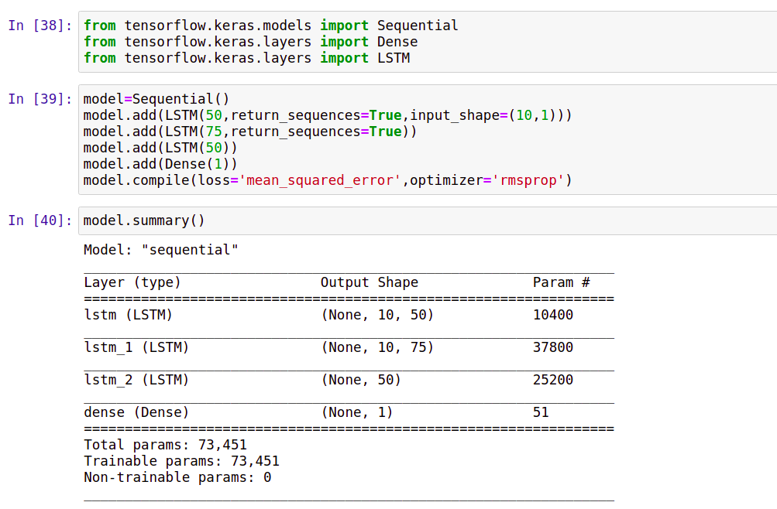
MODEL BUILDING

Slide 16
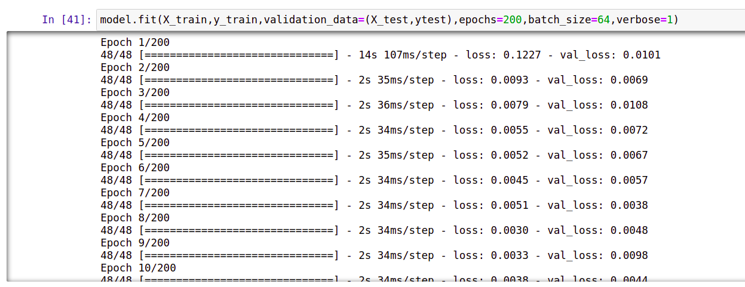
MODEL TRAINING

Slide 17
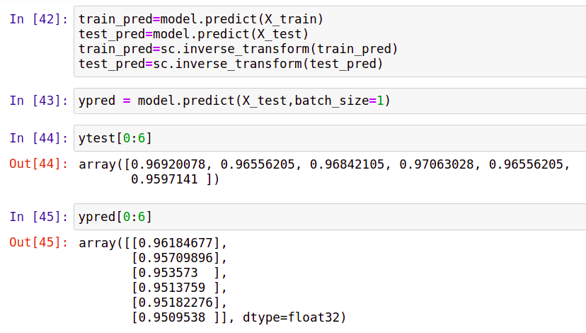
MODEL EVALUATION

Slide 18
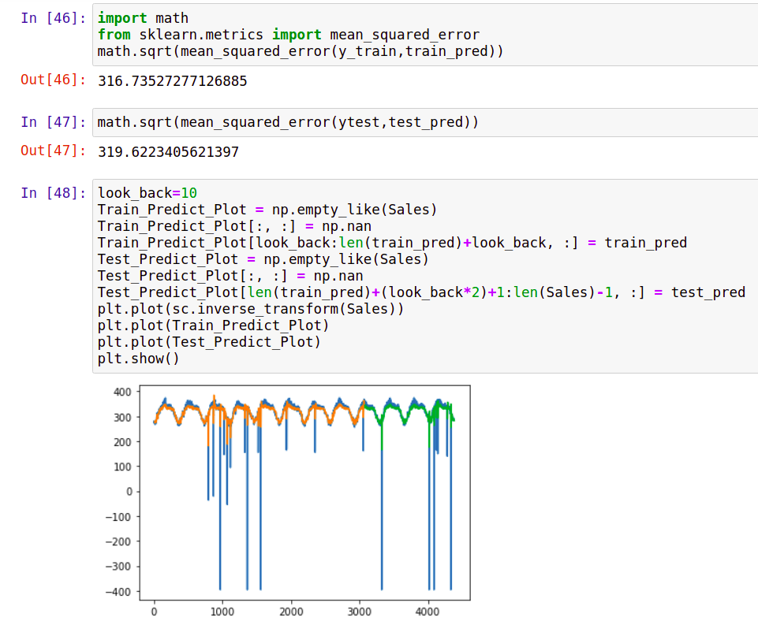
MODEL EVALUATION

Slide 19
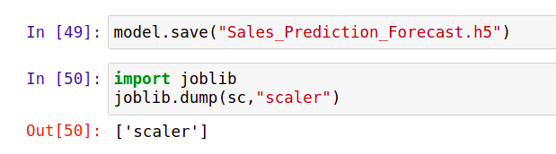
SAVING THE MODEL

Slide 20
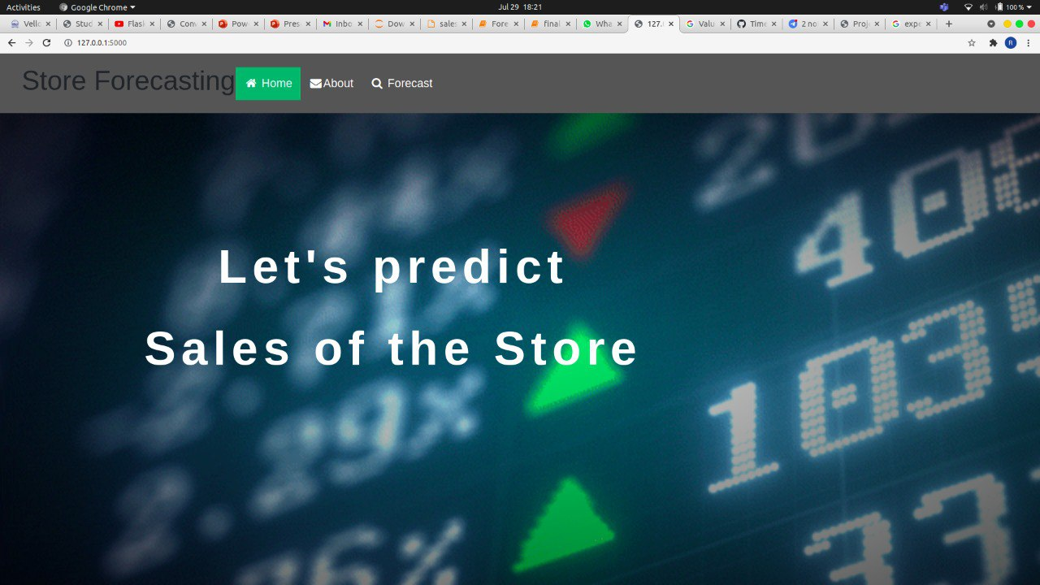
THE APPLICATION

Slide 21
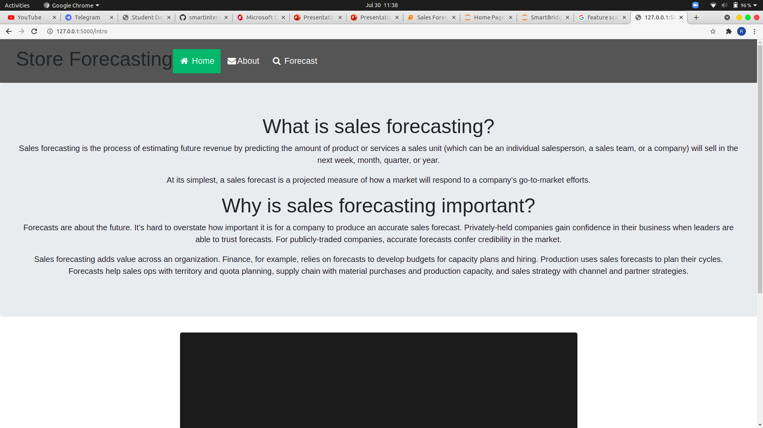
THE APPLICATION - ABOUT PAGE

Slide 22
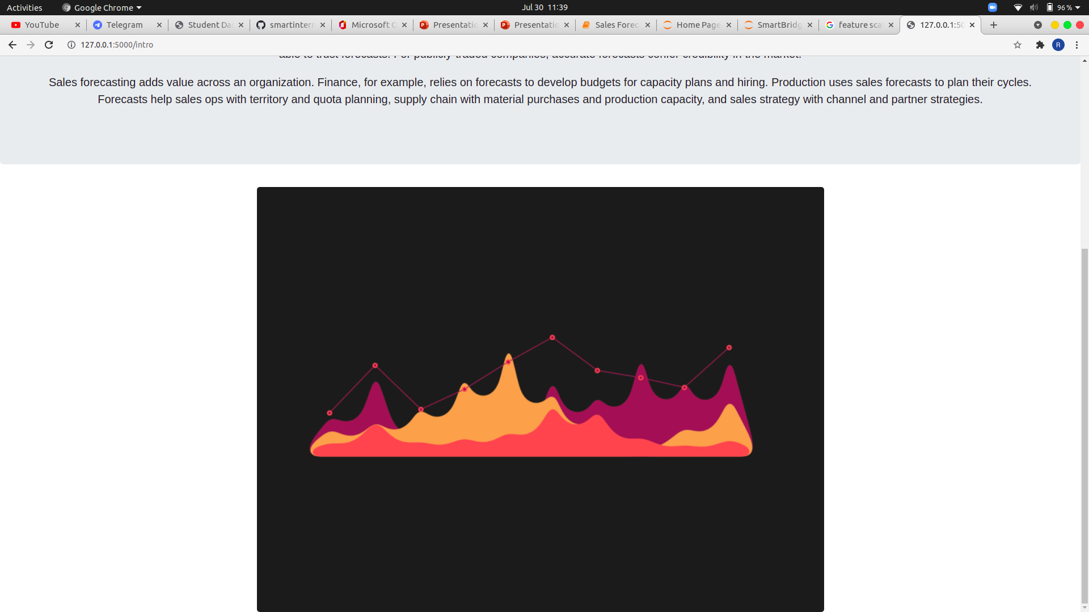
THE APPLICATION - ABOUT PAGE

Slide 23
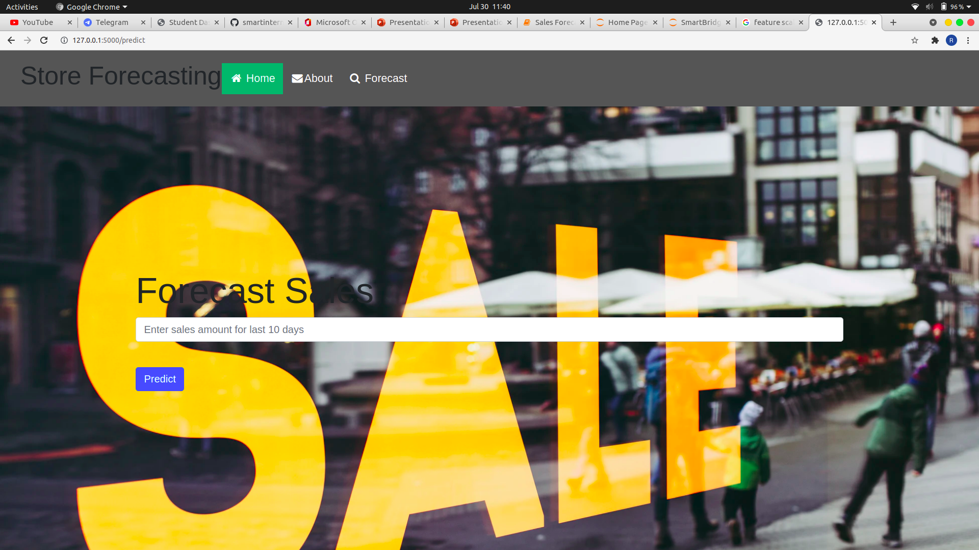
THE APPLICATION - FORECAST PAGE

Slide 24
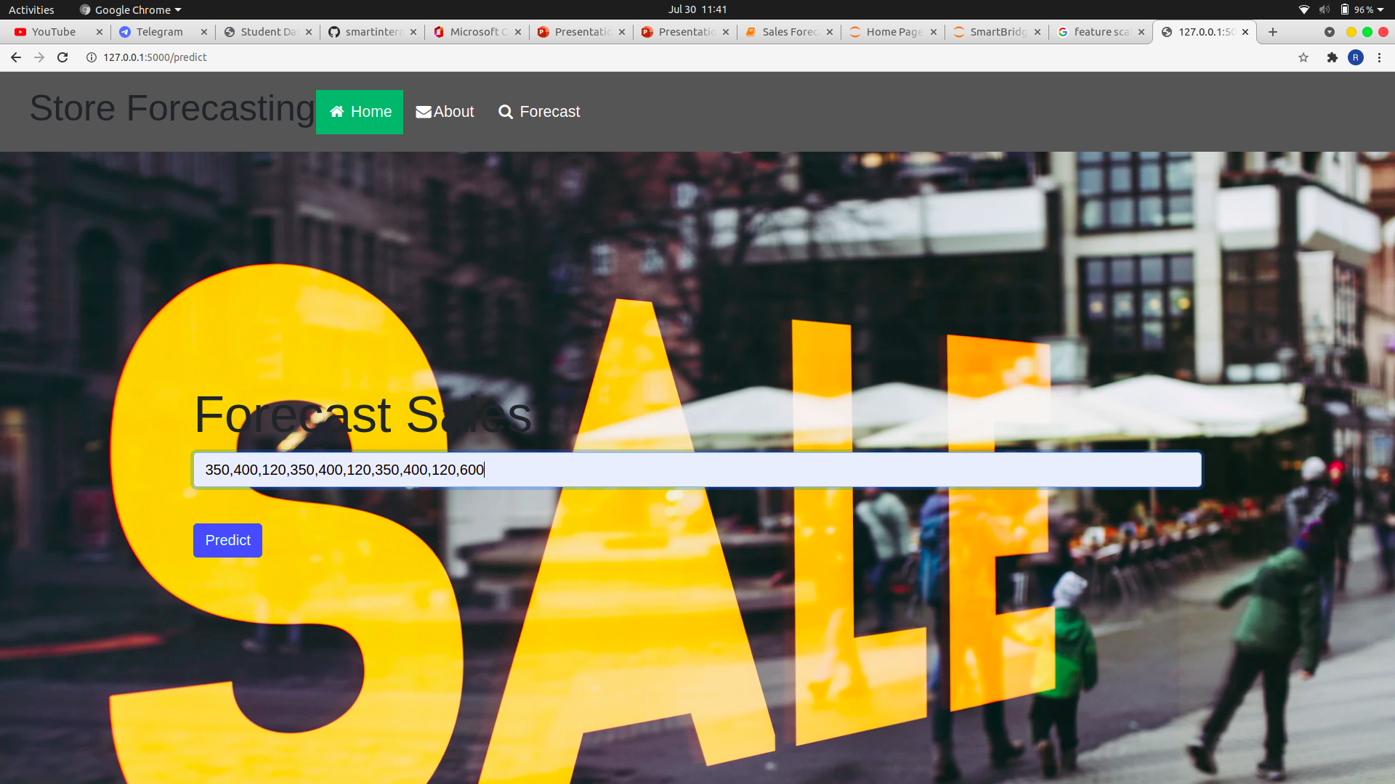
THE APPLICATION - FORECAST PAGE

Slide 25
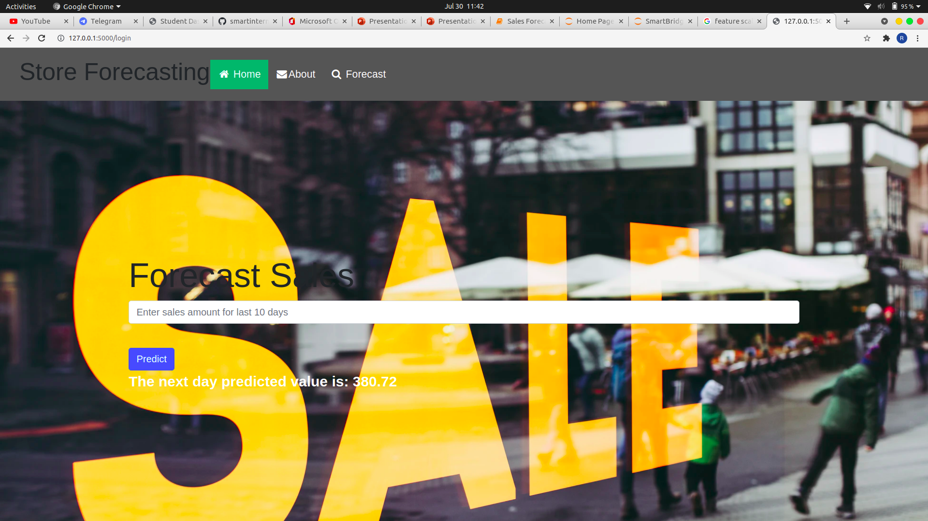
THE APPLICATION - FORECAST PAGE

Slide 26

THE APPLICATION - FORECAST PAGE

Slide 27

THE APPLICATION - FORECAST PAGE

Slide 28
THANK YOU

